Slide 1
Equal tangents
Inspired by a diagram in
“Introducing Pure Mathematics” (Smedley and Wiseman, 2nd edition) p227

Slide 2
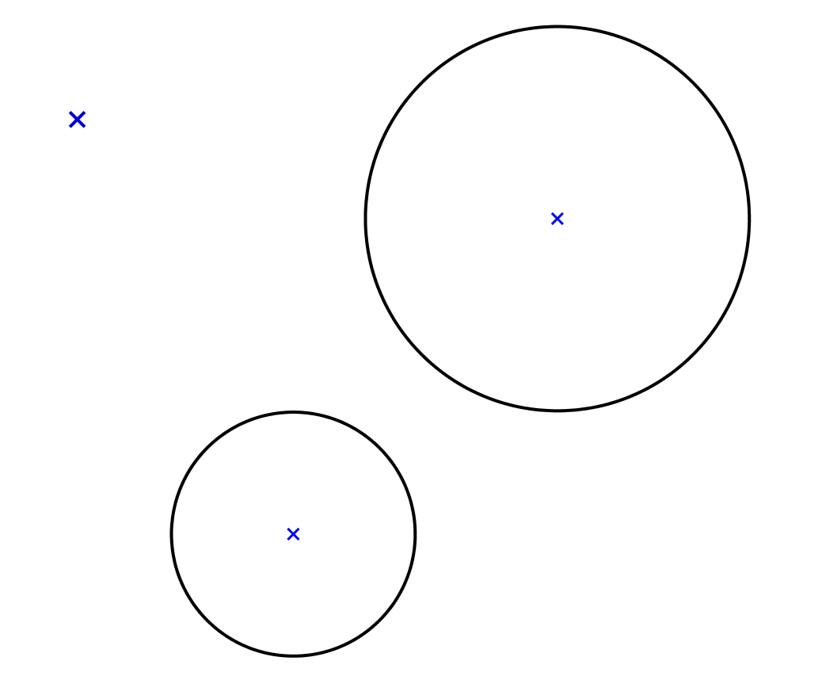






Equal Tangents
$$P$$
The tangents from point $P$ to the circles are of equal length.
The coordinates of the centres of the circles and their radii are as shown.
$$\left(5,3\right)$$
Radius = $2\sqrt{3}$
$$\left(−1,1\right)$$
Radius = $2$
(Not to scale)
What is the relationship between the $x$- and $y$-coordinates of point $P$?

Slide 3
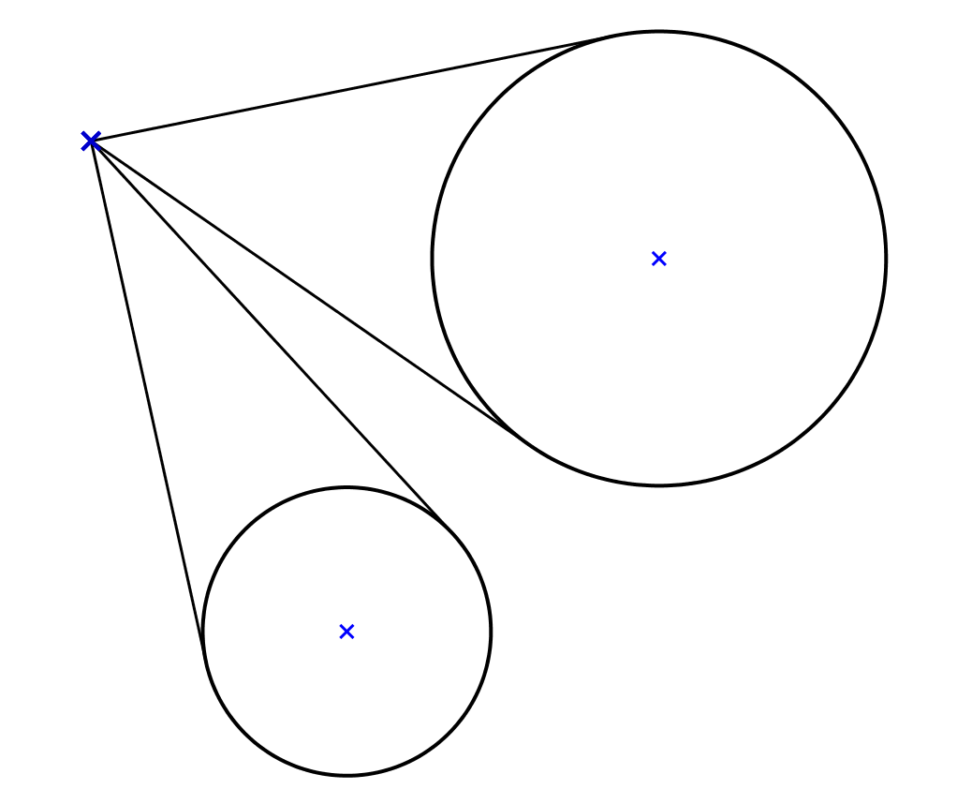
Equal Tangents
$$P$$
Note that there are four such tangents.
$$\left(5,3\right)$$
Radius = $2\sqrt{3}$
$$\left(−1,1\right)$$
Radius = $2$

Slide 4
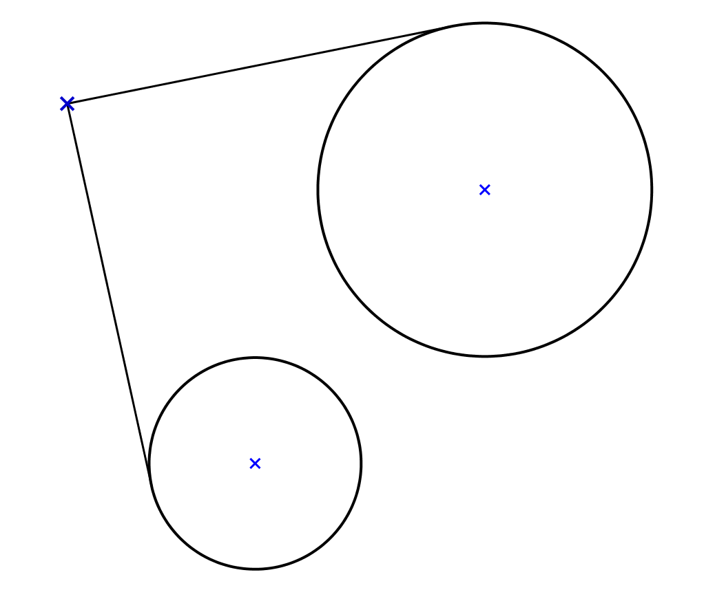
Equal Tangents
$$P$$
$$\left(5,3\right)$$
Radius = $2\sqrt{3}$
$$\left(−1,1\right)$$
Radius = $2$

Slide 5
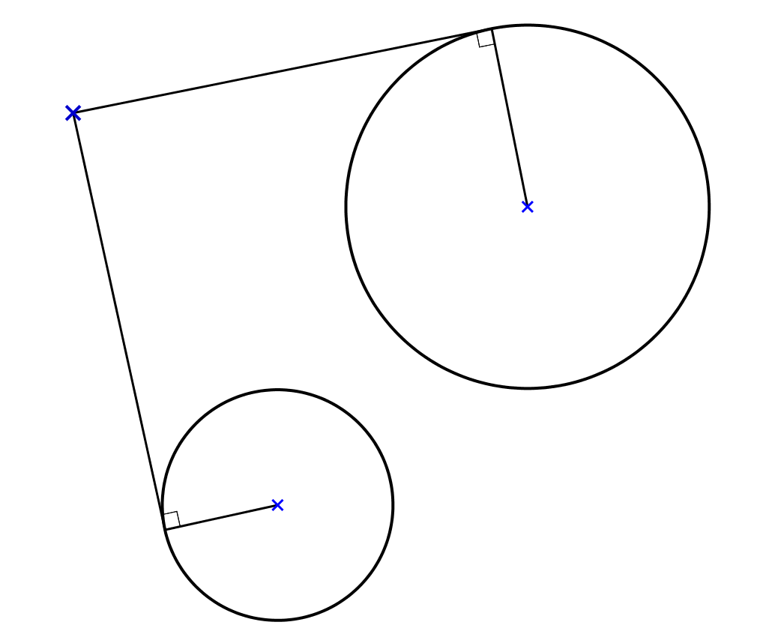


Equal Tangents
$$P$$
$$2\sqrt{3}$$
$$\left(5,3\right)$$
$$2$$
$$\left(−1,1\right)$$

Slide 6
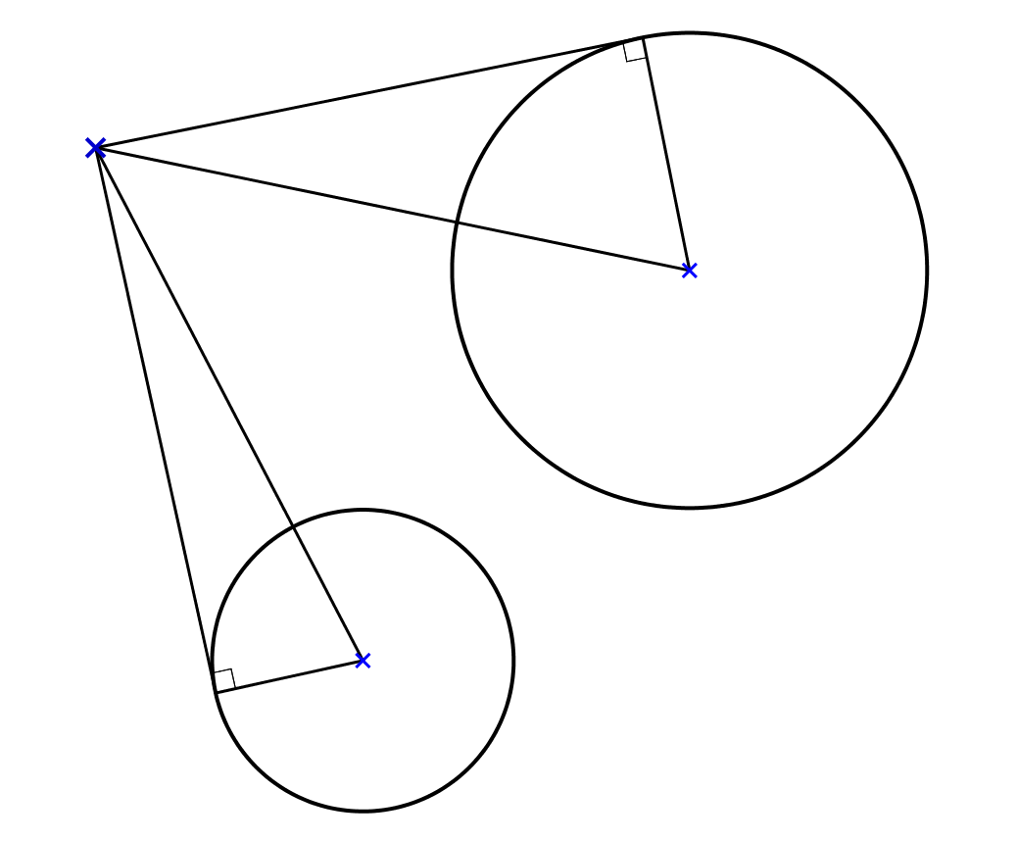
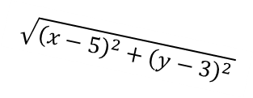

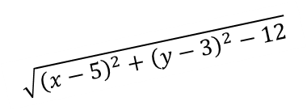
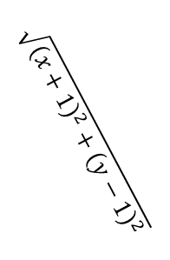

Equal Tangents
$$\sqrt{{\left(x−5\right)}^{2}+{\left(y−3\right)}^{2}−12}$$
$$P$$
$$\left(x,y\right)$$
$$2\sqrt{3}$$
$$\sqrt{{\left(x−5\right)}^{2}+{\left(y−3\right)}^{2}}$$
$$\left(5,3\right)$$
$$\sqrt{{\left(x+1\right)}^{2}+{\left(y−1\right)}^{2}}$$
$$\sqrt{{\left(x+1\right)}^{2}+{\left(y−1\right)}^{2}−4}$$
$$2$$
$$\left(−1,1\right)$$

Slide 7

Equal Tangents
$$P$$
$\sqrt{{\left(x+1\right)}^{2}+{\left(y−1\right)}^{2}−4}=\sqrt{{\left(x−5\right)}^{2}+{\left(y−3\right)}^{2}−12}$
${\left(x+1\right)}^{2}+{\left(y−1\right)}^{2}−4={\left(x−5\right)}^{2}+{\left(y−3\right)}^{2}−12$
$x^{2}+2x+1+y^{2}−2y+1−4=x^{2}−10x+25+y^{2}−6y+9−12$
$2x−2y−2=−10x−6y+22$
$12x+4y=24$
$3x+y=6$

Slide 8
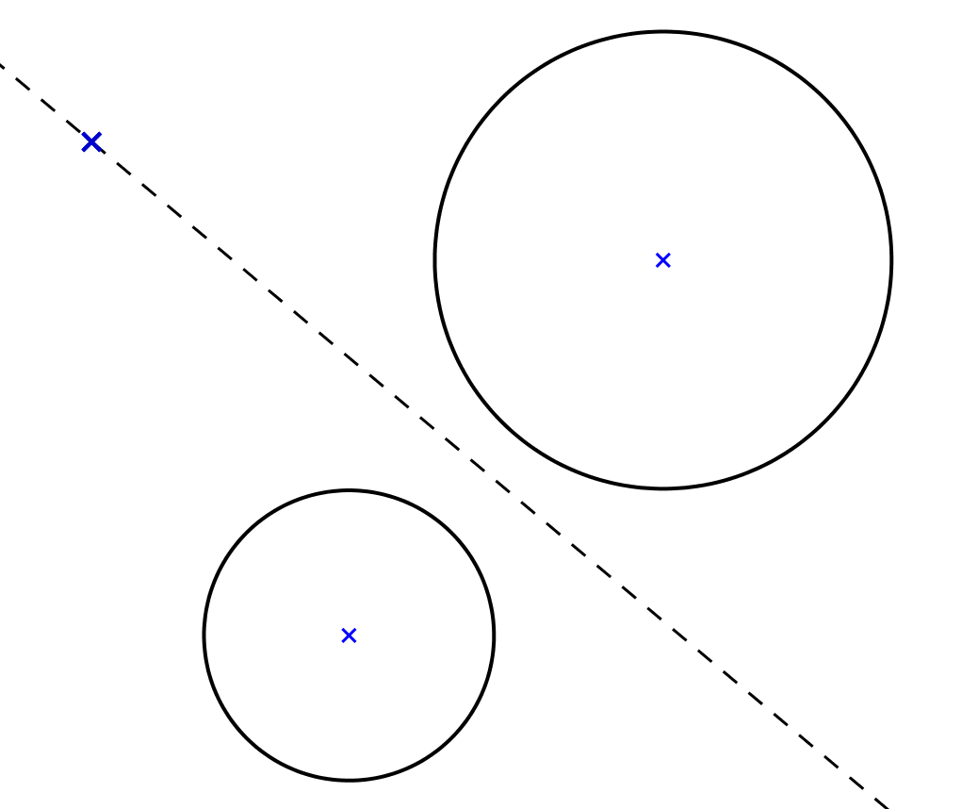

Equal Tangents
$$P$$
$$3x+y=6$$
$$\left(5,3\right)$$
Radius = $2\sqrt{3}$
$$\left(−1,1\right)$$
Radius = $2$

Slide 9
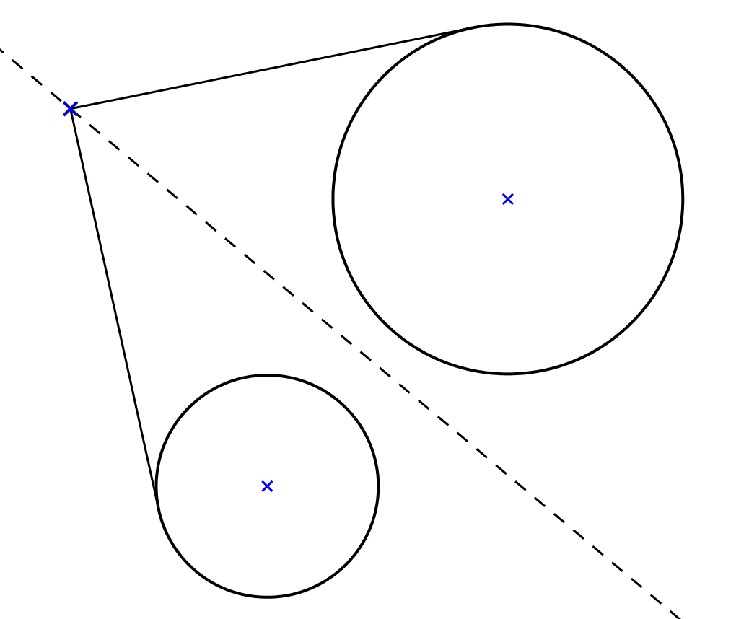
Equal Tangents
$$P$$
$$3x+y=6$$
$$\left(5,3\right)$$
Radius = $2\sqrt{3}$
$$\left(−1,1\right)$$
Radius = $2$

Slide 10
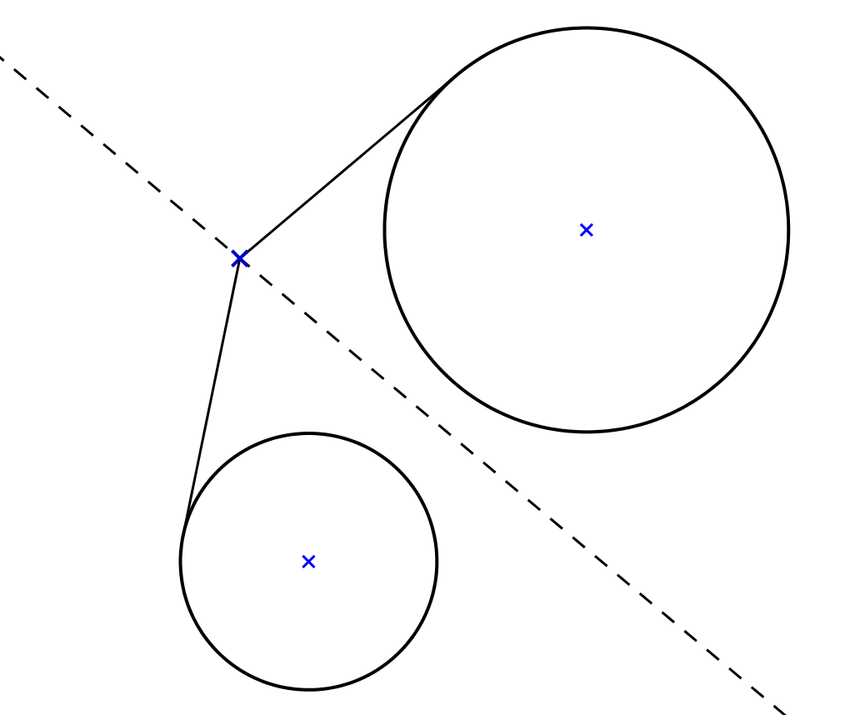
Equal Tangents
$$P$$
$$3x+y=6$$
$$\left(5,3\right)$$
Radius = $2\sqrt{3}$
$$\left(−1,1\right)$$
Radius = $2$

Slide 11
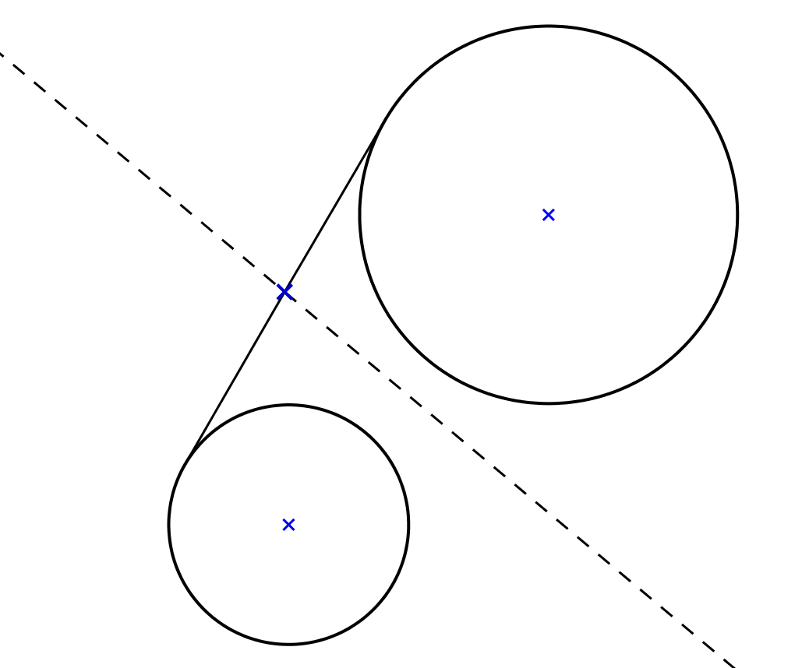
Equal Tangents
$$P$$
$$3x+y=6$$
$$\left(5,3\right)$$
Radius = $2\sqrt{3}$
$$\left(−1,1\right)$$
Radius = $2$

Slide 12
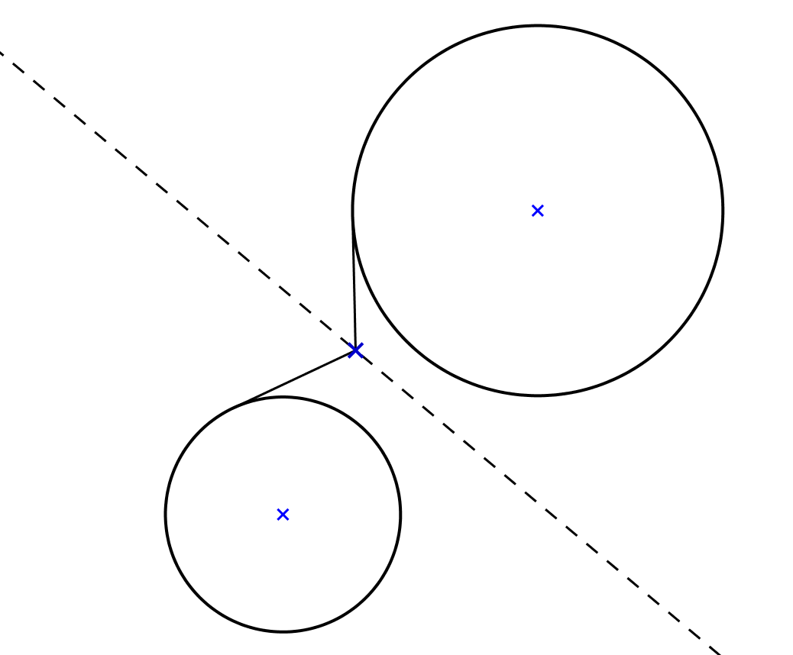
Equal Tangents
$$P$$
$$3x+y=6$$
$$\left(5,3\right)$$
Radius = $2\sqrt{3}$
$$\left(−1,1\right)$$
Radius = $2$

Slide 13
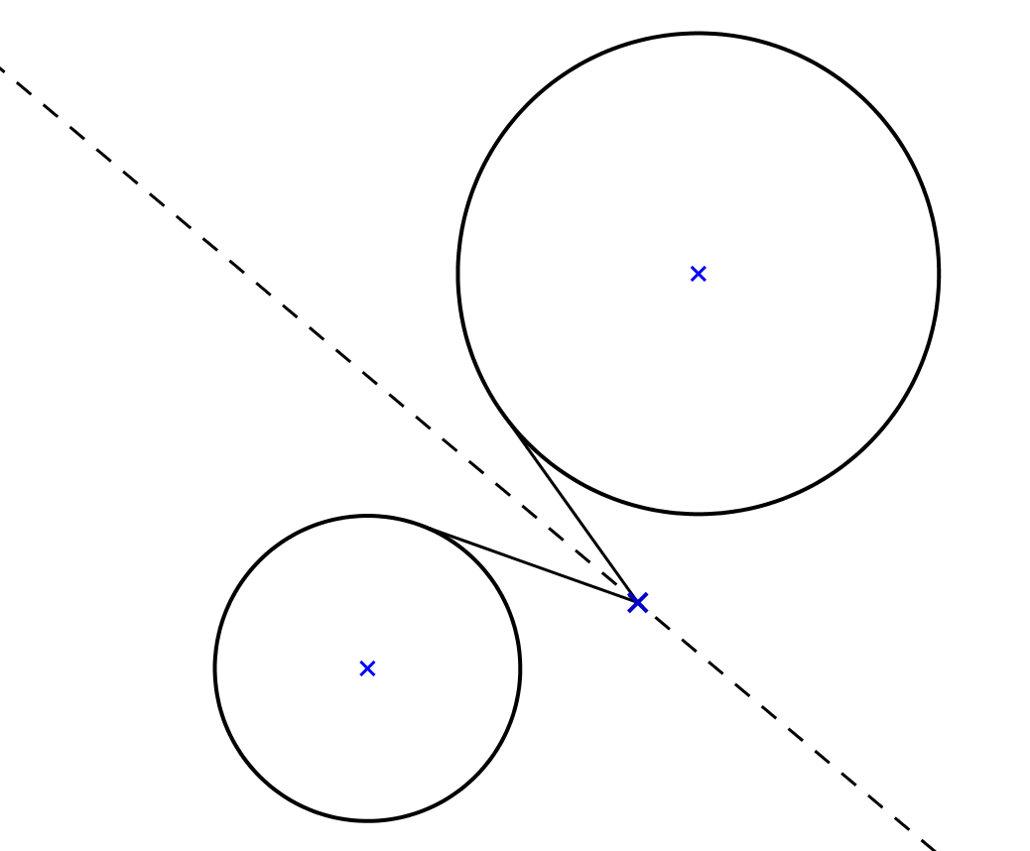
Equal Tangents
$$P$$
$$3x+y=6$$
$$\left(5,3\right)$$
Radius = $2\sqrt{3}$
$$\left(−1,1\right)$$
Radius = $2$

Slide 14
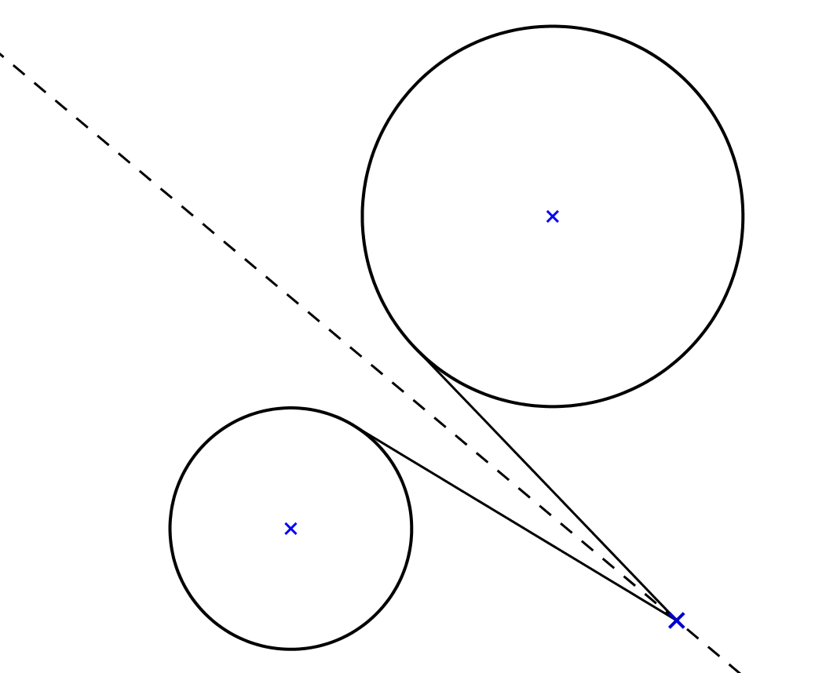
Equal Tangents
$$P$$
$$3x+y=6$$
$$\left(5,3\right)$$
Radius = $2\sqrt{3}$
$$\left(−1,1\right)$$
Radius = $2$

Slide 15
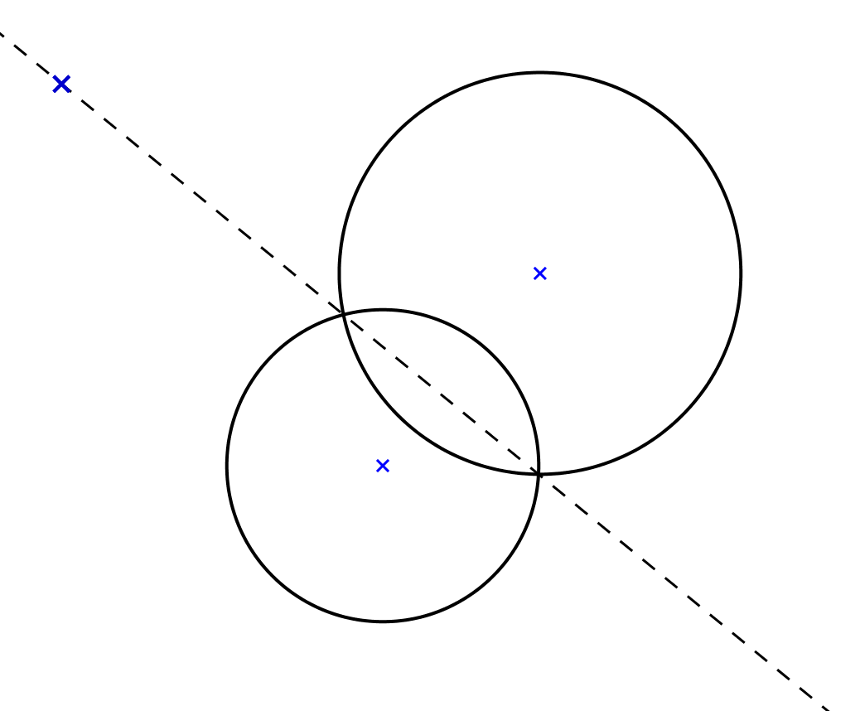

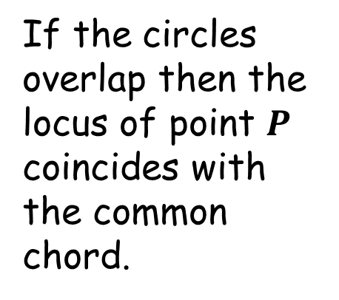
Equal Tangents
$$P$$
If the circles overlap then the locus of point $P$ coincides with the common chord.

Slide 17
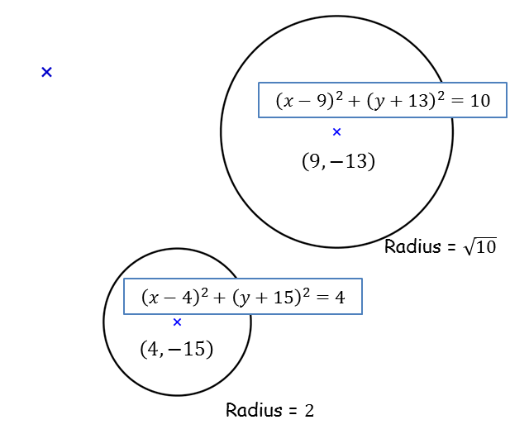


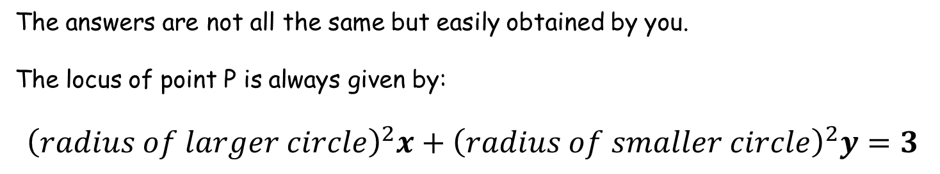
Note to Teacher
The answers are not all the same but easily obtained by you.
The locus of point P is always given by:
$${\left(radius of larger circle\right)}^{2}x+{\left(radius of smaller circle\right)}^{2}y=3$$
$$P$$
(This does not apply to the worked example)
$$10 x+4 y=3$$
See also “An interesting pair of Simultaneous Equations” (SIC_63)

Slide 18
RESOURCES

Slide 19




Equal Tangents
SIC_51
$$P$$
The tangents from point $P$ to the circles are of equal length.
The coordinates of the centres of the circles and their radii are as shown.
$$\left(9,−13\right)$$
Radius = $\sqrt{10}$
$$\left(4,−15\right)$$
A
Radius = $2$
(Not to scale)
What is the relationship between the $x$- and $y$-coordinates of point $P$?

Slide 20


Equal Tangents
SIC_51
$$P$$
The tangents from point $P$ to the circles are of equal length.
The coordinates of the centres of the circles and their radii are as shown.
$$\left(5,−3\right)$$
Radius = $\sqrt{10}$
$$\left(0,−5\right)$$
B
Radius = $2$
(Not to scale)
What is the relationship between the $x$- and $y$-coordinates of point $P$?

Slide 21


Equal Tangents
SIC_51
$$P$$
The tangents from point $P$ to the circles are of equal length.
The coordinates of the centres of the circles and their radii are as shown.
$$\left(7,−8\right)$$
Radius = $\sqrt{10}$
$$\left(2,−10\right)$$
C
Radius = $2$
(Not to scale)
What is the relationship between the $x$- and $y$-coordinates of point $P$?

Slide 22



Equal Tangents
SIC_51
$$P$$
The tangents from point $P$ to the circles are of equal length.
The coordinates of the centres of the circles and their radii are as shown.
$$\left(5,−0.5\right)$$
Radius = $\sqrt{10}$
$$\left(0,−4.5\right)$$
D
Radius = $2\sqrt{2}$
(Not to scale)
What is the relationship between the $x$- and $y$-coordinates of point $P$?

Slide 23


Equal Tangents
SIC_51
$$P$$
The tangents from point $P$ to the circles are of equal length.
The coordinates of the centres of the circles and their radii are as shown.
$$\left(1,4.5\right)$$
Radius = $\sqrt{10}$
$$\left(−4,0.5\right)$$
E
Radius = $2\sqrt{2}$
(Not to scale)
What is the relationship between the $x$- and $y$-coordinates of point $P$?

Slide 24


Equal Tangents
SIC_51
$$P$$
The tangents from point $P$ to the circles are of equal length.
The coordinates of the centres of the circles and their radii are as shown.
$$\left(−3,9.5\right)$$
Radius = $\sqrt{10}$
$$\left(−8,5.5\right)$$
F
Radius = $2\sqrt{2}$
(Not to scale)
What is the relationship between the $x$- and $y$-coordinates of point $P$?

Slide 25



Equal Tangents
SIC_51
$$P$$
The tangents from point $P$ to the circles are of equal length.
The coordinates of the centres of the circles and their radii are as shown.
$$\left(6,−11\right)$$
Radius = $2\sqrt{3}$
$$\left(0,−12\right)$$
G
Radius = $\sqrt{2}$
(Not to scale)
What is the relationship between the $x$- and $y$-coordinates of point $P$?

Slide 26


Equal Tangents
SIC_51
$$P$$
The tangents from point $P$ to the circles are of equal length.
The coordinates of the centres of the circles and their radii are as shown.
$$\left(7,−17\right)$$
Radius = $2\sqrt{3}$
$$\left(1,−18\right)$$
H
Radius = $\sqrt{2}$
(Not to scale)
What is the relationship between the $x$- and $y$-coordinates of point $P$?

Slide 27


Equal Tangents
SIC_51
$$P$$
The tangents from point $P$ to the circles are of equal length.
The coordinates of the centres of the circles and their radii are as shown.
$$\left(8,−23\right)$$
Radius = $2\sqrt{3}$
$$\left(2,−24\right)$$
I
Radius = $\sqrt{2}$
(Not to scale)
What is the relationship between the $x$- and $y$-coordinates of point $P$?

Slide 28


Equal Tangents
SIC_51
$$P$$
The tangents from point $P$ to the circles are of equal length.
The coordinates of the centres of the circles and their radii are as shown.
$$\left(7,−8\right)$$
Radius = $\sqrt{14}$
$$\left(0,−10\right)$$
J
Radius = $2$
(Not to scale)
What is the relationship between the $x$- and $y$-coordinates of point $P$?

Slide 29


Equal Tangents
SIC_51
$$P$$
The tangents from point $P$ to the circles are of equal length.
The coordinates of the centres of the circles and their radii are as shown.
$$\left(5,−1\right)$$
Radius = $\sqrt{14}$
$$\left(−2,−3\right)$$
K
Radius = $2$
(Not to scale)
What is the relationship between the $x$- and $y$-coordinates of point $P$?

Slide 30


Equal Tangents
SIC_51
$$P$$
The tangents from point $P$ to the circles are of equal length.
The coordinates of the centres of the circles and their radii are as shown.
$$\left(3,6\right)$$
Radius = $\sqrt{14}$
$$\left(−4,4\right)$$
L
Radius = $2$
(Not to scale)
What is the relationship between the $x$- and $y$-coordinates of point $P$?

Slide 31



Equal Tangents
SIC_51
$$P$$
The tangents from point $P$ to the circles are of equal length.
The coordinates of the centres of the circles and their radii are as shown.
$$\left(9,−31\right)$$
Radius = $4$
$$\left(1,−32\right)$$
M
Radius = $\sqrt{2}$
(Not to scale)
What is the relationship between the $x$- and $y$-coordinates of point $P$?

Slide 32


Equal Tangents
SIC_51
$$P$$
The tangents from point $P$ to the circles are of equal length.
The coordinates of the centres of the circles and their radii are as shown.
$$\left(8,−23\right)$$
Radius = $4$
$$\left(0,−24\right)$$
N
Radius = $\sqrt{2}$
(Not to scale)
What is the relationship between the $x$- and $y$-coordinates of point $P$?

Slide 33


Equal Tangents
SIC_51
$$P$$
The tangents from point $P$ to the circles are of equal length.
The coordinates of the centres of the circles and their radii are as shown.
$$\left(7,−15\right)$$
Radius = $4$
$$\left(−1,−16\right)$$
O
Radius = $\sqrt{2}$
(Not to scale)
What is the relationship between the $x$- and $y$-coordinates of point $P$?

Slide 34


Equal Tangents
SIC_51
$$P$$
The tangents from point $P$ to the circles are of equal length.
The coordinates of the centres of the circles and their radii are as shown.
$$\left(6,−11.5\right)$$
Radius = $\sqrt{10}$
$$\left(1,−12.5\right)$$
P
Radius = $\sqrt{2}$
(Not to scale)
What is the relationship between the $x$- and $y$-coordinates of point $P$?

Slide 35


Equal Tangents
SIC_51
$$P$$
The tangents from point $P$ to the circles are of equal length.
The coordinates of the centres of the circles and their radii are as shown.
$$\left(5,−6.5\right)$$
Radius = $\sqrt{10}$
$$\left(0,−7.5\right)$$
Q
Radius = $\sqrt{2}$
(Not to scale)
What is the relationship between the $x$- and $y$-coordinates of point $P$?

Slide 36


Equal Tangents
SIC_51
$$P$$
The tangents from point $P$ to the circles are of equal length.
The coordinates of the centres of the circles and their radii are as shown.
$$\left(4,−1.5\right)$$
Radius = $\sqrt{10}$
$$\left(−1,−2.5\right)$$
R
Radius = $\sqrt{2}$
(Not to scale)
What is the relationship between the $x$- and $y$-coordinates of point $P$?

